Slide 1
3D Interactive Media Development
5MMCS001W Lecture 07
https://www.blend4web.com/apps/dairy_plant/dairy_plant.html?v=93906d9bd04fe610df690c519724295f

Slide 2
3D Interactive Media Development
Troubleshooting
Button Animate Demo
Unity Packages Demo

Slide 3
3D Interactive Media Development
Unity Input Manager - Also Tutorial 2-3
Each program you write, whether the program is a phone application, a web application, a game or an embedded system, needs some sort of an input. In general every program needs some sort of an input and some sort of an output. The output is what the users sees, and the input is what the user enters or gives to the program to generate the output based on some algorithm.
Unity 3D is no different. The game engine needs to be able to process inputs from different sources:
Keyboard
Mouse
Joystick(s)
Unity 3D manages its inputs through the Input Manager. The Input Manager is accessible by selecting Edit->Project Settings->Input from the main menu bar.

Slide 4
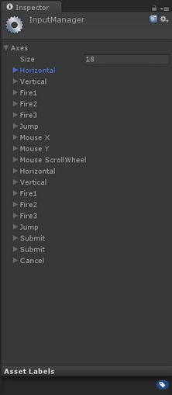
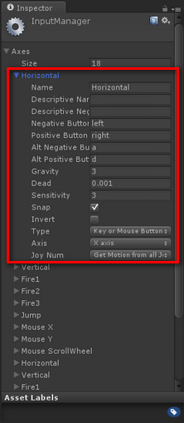
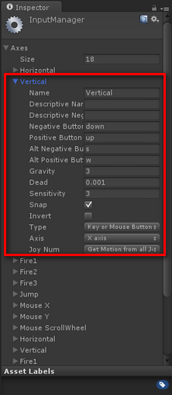
3D Interactive Media Development
Input Manager - Also Tutorial 2-3

Slide 5
3D Interactive Media Development
Unity Input Manager – Tut 7.1
Figure 1 lists all of the out of the box Input configurations defined in the game engine. Let’s go ahead and expand the first Input Definition called Horizontal. Looking at Figure 2, you will notice the attributes that are defined under the Horizontal Axis input configuration. The following are the properties of the input configuration that are important to take a note of:
Name: the name of the axis as defines in the Input Manager. This is the name that you can refer to in your C# code for to detect and perform an operation as desired.
Positive Button: defines the primary button that will provide the positive direction / force.
Negative Button: defines the primary button that will provide the negative direction / force.
Alt. Positive Button: same as the positive button, but defines a secondary input intake.
Alt. Negative Button: same as the negative button, but defines a secondary input intake.
Type: defines where the input source is coming from; (Keyboard/Mouse/Joystick).
Axis: which axis in the world should the force be applied to.

Slide 6
3D Interactive Media Development
Unity Input Manager – Tut 7.1
Input key values to handle the rotation for the dynamically created primitives in the following order:
Key A will be responsible to rotate Cube1’ on the Y-Axis.
Key B will be responsible to rotate Cube2’ on the X-Axis.
Key C will be responsible to rotate Cube3’ on the Z-Axis.
Notice, that the Update() function is where you place the logic to perform your Input and Output. The code checks to see if the primitives have been initialized, and if true, then it will check for input from the user. Based on the key value it will apply the appropriate rotation to the Game Object.
Each primitive will rotate independently only when the specific key associated to its rotation is pressed. For instance, if you press the A key, Cube1’ will continuously rotate until you stop pressing it. It will stop at the last rotation angle where you lifted your finger from the key.
Noorcon Inc. - Unity 3D Game Programming Part 3 - Vahe Karamian.pdf

Slide 7
3D Interactive Media Development
Unity Input Manager/Movement Scripting – Tut 7.1
CreatePrimitivesFromImport.cs – on Main Camera, Can access all Cube Game Objects
if(Input.GetKey(KeyCode.A)){ this.cube1.transform.Rotate(new Vector3(0,1,0), 1); } // apply the x-axis transform to Cube2'
if(Input.GetKey(KeyCode.B)){ this.cube2.transform.Rotate(new Vector3(1,0,0), 1); } // apply the z-axis transform to Cube3' if(Input.GetKey(KeyCode.C)){ this.cube3.transform.Rotate(new Vector3(0,0,1), 1); }
http://www.noorcon.com/articles/Unity3D_Game_Programming_Part_4.html

Slide 8
3D Interactive Media Development
Unity Animator Scripting - Tut 5
Array, Animate, Export from Max
New Project, Import
Divide into Static, Explode, Implode animations
Set up Animator
Script for Input
Notes:
https://www.youtube.com/watch?v=H9Ptme4fYR0

Slide 9
3D Interactive Media Development
Unity UI

Slide 10
3D Interactive Media Development
Unity UI Architecture
UnityEngine.UI Namespace - using UnityEngine.UI; Canvas, RectTransform
Button, Image, Panel, Text
Prefabs
Events, Event Triggers
Slider
Transitions

Slide 11
3D Interactive Media Development
Unity UI Architecture
using UnityEngine.UI;
Canvas – Base component of UI
Screen Space Overlay – exactly to screen size, nothing rendered in front
Screen Space Camera – Similar, but affected by camera settings
(Perspective vs orthographic)
World Space – makes a 3D world object
(in game screens)
Drawn in Hierarchy order
Images, Buttons, Text all children of this
Dragged into boxes to wire up
Event System

Slide 12
3D Interactive Media Development
Unity UI Architecture
https://unity3d.com/learn/tutorials/topics/user-interface-ui/ui-events-and-event-triggers
using UnityEngine.UI;
Event System - Game Object
Allows UI elements to be selected
Input Modules
Gamepad and keyboard/mouse
Touch
Unity input is a class and a manager
Determine Event Firing for UI
OnClick event – Pointer Down and Pointer Up Event needed in Component
Button Component has Function list box
EventTrigger
Image Component would need this
https://docs.unity3d.com/Packages/com.unity.ugui@1.0/manual/script-EventTrigger.html
https://docs.unity3d.com/Packages/com.unity.ugui@1.0/manual/SupportedEvents.html

Slide 13
3D Interactive Media Development
Unity UI Architecture
https://unity3d.com/learn/tutorials/topics/user-interface-ui/ui-events-and-event-triggers
using UnityEngine.UI;
Determine Event Firing for UI
OnClick event – Pointer Down and Pointer Up Event needed in Component
Button Component has Function list box
EventTrigger
Image Component would need this
Tut 7.1b (extra)
Dragging Game Object in will expose Components and Functions for use
Must be Public, Void, and of no or 1 parameter of: float, int, str, or Object
Can call on attached scripts as well
access as component in script or
drag itself into box

Slide 14
3D Interactive Media Development
Unity UI Architecture https://www.lynda.com/Unity-tutorials/Create-button-element/489008/519845-4.html
Text – most fundamental UI element
display game readouts, dialogue, instructions, menus
Wired up by dragging UI Text Element into exposed Public Var Box of Script
Used in conjunction with other element
pre built into buttons as child
Creating UI text creates Canvas Parent
Zero out, adjustments
Modify at runtime with scripts
Text Readout Tutorial: 7.1

Slide 15
3D Interactive Media Development
Unity UI Architecture
https://www.lynda.com/Unity-tutorials/Create-button-element/489008/519845-4.html
Button – most Common UI element
Direct Interaction
Comes with text element
Can use images
Creating UI Button creates Canvas Parent
Zero out, Adjust rect transform
Has transition (hover, click)
Event Handler
On Click
Modify Text Element of Button at runtime Drag Text element into OnClick Box
Modify Text Object, Script, and string text Property in function to I’m clicked
dynamic objects cant be selected.

Slide 16
3D Interactive Media Development
Unity UI Architecture
Noorcon Inc. - Unity 3D Game Programming Part 4 - Vahe Karamian.pdf
Basics:
HUD Text Readout from Script Public Variable Noorcon Inc. - Unity 3D Game Programming Part 4 - Vahe Karamian.pdf
Button OnClick Event Handling (Associated Functions must be public and void)
Noorcon Inc. - Unity 3D Game Programming Part 4 - Vahe Karamian.pdf
Button Runtime text feedback https://www.lynda.com/Unity-tutorials/Create-button-element/489008/519845-4.html

Slide 17
3D Interactive Media Development
Tutorial 1. Unity UI HUD
Initialize Cubes (with rotation)
Noorcon Inc. - Unity 3D Game Programming Part 2 - Vahe Karamian.pdf
Initialize more Cubes from Button (4.2)
Button OnClick Event Handling (Associated Functions must be public and void)
Noorcon Inc. - Unity 3D Game Programming Part 4 - Vahe Karamian.pdf
Animate rotation from key
Button OnClick Event Handling (Associated Functions must be public and void)
Noorcon Inc. - Unity 3D Game Programming Part 3 - Vahe Karamian.pdf
HUD Text Readouts in Unity UI Text and Panels (from Script Public Variable)
Noorcon Inc. - Unity 3D Game Programming Part 4 - Vahe Karamian.pdf
Notes:
String format shows P for position, R for rotation, and 3 values to 2 floating point value….
Noorcon Inc. - Unity 3D Game Programming Introduction - Vahe Karamian.pdf

Slide 18
3D Interactive Media Development
Tutorial 7 Unity UI HUD
7.1 Cubes with HUD Text Readouts in Unity UI Text and Panels
(from Script Public Variable)
Extras
7.1a Initialize (Spawn) Cubes from key
(with translate control by key)
7.1b Button Event Handling (rather than Week 5 – OnClick)
(Associated Functions must be public and void)
7.1c Button Event Handling on Instantiated Cube (both above combined)
7.1d Instantiate Prefab
7.2 Text Readout Score
7.3 Animated Legacy Button
7.4 Animated Text Mesh Pro Button
Notes:
String format shows P for position, R for rotation, and 3 values to 2 floating point value….
Noorcon Inc. - Unity 3D Game Programming Introduction - Vahe Karamian.pdf

Slide 19
3D Interactive Media Development
Tutorial 7.1 Unity UI HUD
GO Main Camera
CreatePrimitivesFromInput.cs
Spawn from space key
Translate from arrow keys
As stretch target, try spawning prefabs of below cubes with scripts and readout
GO UI Canvas
GO UI Panel
GO UI legacy Text
GO Cube x 3
CubexRotate.cs
Rotate scripted movement (narrative)
Private String variable of live rotation data
Public GO UI Text variable – related GO UI Legacy text above dragged into box in Inspector
Notes:
String format shows P for position, R for rotation, and 3 values to 2 floating point value….
Noorcon Inc. - Unity 3D Game Programming Introduction - Vahe Karamian.pdf

Slide 20
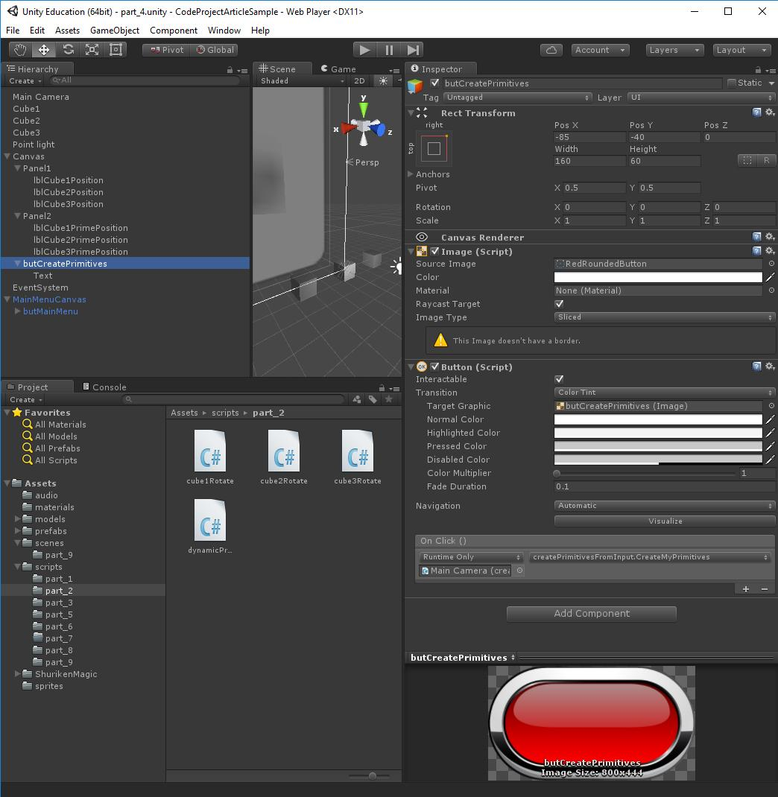
3D Interactive Media Development
Tutorial 7.1 Unity UI Initialize Game Objects
Noorcon Inc. - Unity 3D Game Programming Part 4 - Vahe Karamian.pdf
Button (OnClick event and public void function) Drag object with Script and Function to OnClick Placeholder Select function from drop down box
// This function will be called when the Space Bar on the keyboard is pressed public void CreateMyPrimitives(){
if (!this.PRIMITIVES_CREATED) {
// initialize our Cube1 primitive and place it at location (0,2,0) this.cube1 = GameObject.CreatePrimitive (PrimitiveType.Cube); this.cube1.transform.localPosition = new Vector3 (0, 2, 0);
// initialize our Cube2 primitive and place it at location (3,2,0) this.cube2 = GameObject.CreatePrimitive (PrimitiveType.Cube); this.cube2.transform.localPosition = new Vector3 (3, 2, 0);
// initialize our Cube3 primitive and place it at location (-3,2,0) this.cube3 = GameObject.CreatePrimitive (PrimitiveType.Cube); this.cube3.transform.localPosition = new Vector3 (-3, 2, 0);
this.PRIMITIVES_CREATED = true;
}
Notes:
Score:
http://www.noorcon.com/articles/Unity3D_Game_Programming_Part_6.html

Slide 21
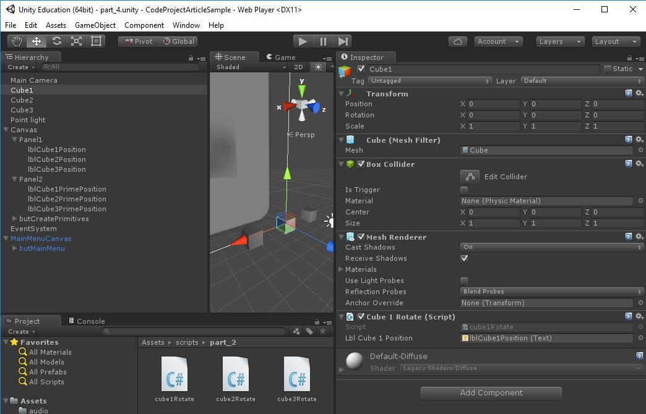
3D Interactive Media Development
Tutorial 7.1 Unity UI HUD Noorcon Inc. - Unity 3D Game Programming Part 4 - Vahe Karamian.pdf
Text Readouts on Panels- Basic
using UnityEngine;
using UnityEngine.UI;
using System.Collections;
public class cube1Rotate : MonoBehaviour {
// variable to store Text UI Element
public Text lblCube1Position;
private string position = "";
// Use this for initialization
void Start () {
}
// Update is called once per frame
void Update () {
// Rotate our game object around it's y-axis
transform.Rotate (new Vector3 (0, 1, 0), 1);
if (this.lblCube1Position != null) {
//F2 is float to string
position = string.Format("P:<{0:F2},{1:F2},{2:F2}>; R:<{3:F2},{4:F2},{5:F2}>",
transform.localPosition.x,
transform.localPosition.y,
transform.localPosition.z,
transform.localEulerAngles.x,
transform.localEulerAngles.y,
transform.localEulerAngles.z);
this.lblCube1Position.text = position;
}
}
}
Notes:
String format shows P for position, R for rotation, and 3 values to 2 floating point value….

Slide 22
3D Interactive Media Development
Tutorial 7.1 Unity UI HUD
Extras
7.1a Initialize (Spawn) Cubes from key
(with translate control by key)
7.1b Button Event Handling (rather than Week 5 – OnClick)
(Associated Functions must be public and void)
7.1c Button Event Handling on Instantiated Cube (both above combined)
7.1d Instantiate Prefab
Notes:
String format shows P for position, R for rotation, and 3 values to 2 floating point value….
Noorcon Inc. - Unity 3D Game Programming Introduction - Vahe Karamian.pdf

Slide 23
3D Interactive Media Development
Tutorial 7.1 Unity UI HUD
Extras
7.1a Initialize (Spawn) Cubes from key
(with translate control by key)
Notes:
String format shows P for position, R for rotation, and 3 values to 2 floating point value….
Noorcon Inc. - Unity 3D Game Programming Introduction - Vahe Karamian.pdf

Slide 24
3D Interactive Media Development
Tutorial 7.1 Unity UI HUD
Extras
7.1b Button Event Handling (rather than Week 5 – OnClick)
(Associated Functions must be public and void)
Notes:
String format shows P for position, R for rotation, and 3 values to 2 floating point value….
Noorcon Inc. - Unity 3D Game Programming Introduction - Vahe Karamian.pdf

Slide 25
3D Interactive Media Development
Tutorial 7.1 Unity UI HUD
Extras
7.1c Button Event Handling on Instantiated Cube (both above combined)
Notes:
String format shows P for position, R for rotation, and 3 values to 2 floating point value….
Noorcon Inc. - Unity 3D Game Programming Introduction - Vahe Karamian.pdf

Slide 26
3D Interactive Media Development
Tutorial 7.1 Unity UI HUD
Extras
7.1d Instantiate Prefab
Notes:
String format shows P for position, R for rotation, and 3 values to 2 floating point value….
Noorcon Inc. - Unity 3D Game Programming Introduction - Vahe Karamian.pdf

Slide 27
3D Interactive Media Development
We can continue with Unity UI with extra features in the next tutorials >>>
Notes:
Score:
http://www.noorcon.com/articles/Unity3D_Game_Programming_Part_6.html

Slide 28
3D Interactive Media Development
Extra - Tutorial 7.2 Unity UI HUD Text Readout Score – Simplified
UI Cookbook chapter 2
1. Make UI/Text – call it “Score Counter”
2. Add Component/Script
3. Create Text “uiText” and “score” variables
private Text uiText;
private long score = 0;
4. In Start – uiText = GetComponent<Text>();
void Start () {
uiText = this.GetComponent<Text> ();
updateScoreCounter ();
}
5. Add Points (run script when key is pressed - remember how to do this?)
public void addPoints(int points){
score += points;
updateScoreCounter ();
}
6. Method outside of update
private void updateScoreCounter(){
uiText.text = "<color=blue>Score</color>: " + score;
}

Slide 29
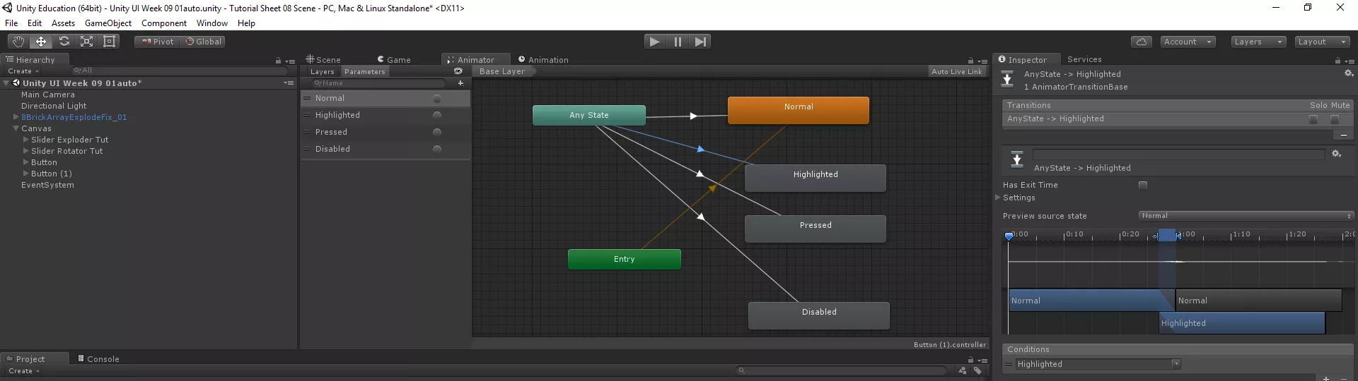
3D Interactive Media Development
Extra - Tutorial 7.3 Animate UI Button
https://youtu.be/mgaUKk8hfjg
Notes:
https://www.assetstore.unity3d.com/en/#!/content/25468
Slider – control and display
https://www.youtube.com/watch?v=lNdhNHNwpjI
Layouts and Spaces
https://www.youtube.com/watch?v=OD-p1eMsyrU
Animated Buttons

Slide 30
3D Interactive Media Development
Extra - Tutorial 7.4 Animate UI Button TextMeshPro
https://youtu.be/mgaUKk8hfjg
Notes:
https://www.assetstore.unity3d.com/en/#!/content/25468
Slider – control and display
https://www.youtube.com/watch?v=lNdhNHNwpjI
Layouts and Spaces
https://www.youtube.com/watch?v=OD-p1eMsyrU
Animated Buttons

Slide 31
3D Interactive Media Development
Unity UI Tutorials General Interface
Official Unity
https://unity3d.com/learn/tutorials/topics/user-interface-ui/ui-canvas?playlist=17111
https://unity3d.com/learn/tutorials/modules/beginner/live-training-archive/the-new-ui?playlist=17111
Notes:
https://www.assetstore.unity3d.com/en/#!/content/25468
Slider – control and display
https://www.youtube.com/watch?v=lNdhNHNwpjI
Layouts and Spaces
https://www.youtube.com/watch?v=OD-p1eMsyrU
Animated Buttons

Slide 32
3D Interactive Media Development
Unity UI Menu Various (Games)
Readouts: Noorcon Inc. - Unity 3D Game Programming Part 4 - Vahe Karamian.pdf
Health Bar: Noorcon Inc. - Unity 3D Game Programming Part 9 - Vahe Karamian.pdf
https://www.packtpub.com/mapt/book/Game%20Development/9781785885822/2/ch02lvl1sec23/Implementing+a+linear+health+bar
Timer: Noorcon Inc. - Unity 3D Game Programming Part 6 - Vahe Karamian.pdf https://www.packtpub.com/mapt/book/Game%20Development/9781785885822/3/ch03lvl1sec29/Implementing+a+numeric+timer
Collection Bar: Noorcon Inc. - Unity 3D Game Programming Part 6 - Vahe Karamian.pdf
Score/Info: Noorcon Inc. - Unity 3D Game Programming Part 6 - Vahe Karamian.pdf
https://www.packtpub.com/mapt/book/Game%20Development/9781785885822/2/ch02lvl1sec19/Implementing+a+score+counter

Slide 33
3D Interactive Media Development
Unity UI Menu and Levels
Scene/Level Switching (Scene manager):
https://www.youtube.com/watch?v=xyC_flufHwg
Notes:
Scene/Level selection
https://www.youtube.com/watch?v=FIa7qxGaRZo&index=86&list=PLX2vGYjWbI0Tg4eS9w29PPqg0Fx4sIL7p
Minimaps https://www.packtpub.com/mapt/book/Game%20Development/9781785885822
https://www.packtpub.com/mapt#collapse10

Slide 34
3D Interactive Media Development
Unity UI Widgets
Player Control
https://www.youtube.com/watch?v=nGYObojmkO4
Shop UI with ScrollLists
https://www.youtube.com/watch?v=TAJCr3_kfEc

